Slide 1
Telecom Churn Analysis

Slide 2
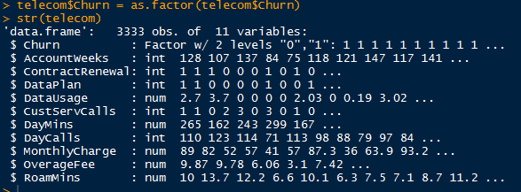
Data Summary
Variable churn has been transformed to factor instead of int as the variable churn is to be considered as a dependent variable in the model to be built using logistic regression.

Slide 3
Exploratory Data Analysis
The dataset consists of 11 variables and 3333 observations.
We are trying to develop a model that can predict the propensity of a customer to churn.
Dataset contains a Categorical as well as Continuous type of data.
In the current dataset 14% of the customers are churned customers i.e. they have cancelled the services.
Hence in our analysis Churn would be the target or the response variable i.e the Dependent variable and other variables would be independent or the predictor variables.
There are no missing values in the dataset , hence no treatment is required for the missing values.

Slide 4
Hypothesis
To predict the propensity of the churned customers variables churn has been taken as response variable and rest of the variables are taken as independent or the predictor variables.

Slide 5
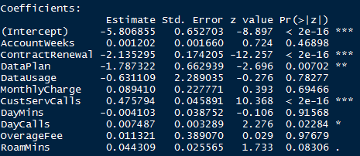
Hypothesis
Null Hypothesis (H₀) – There is no impact of any of the independent variables on Churn , i.e. the mean of all the independent variables are equal.
Alternative Hypothesis (Hₐ) – At least one of the independent variable is having a significant impact on Churn.
Above are the summary results of the model that is built , which suggests the null hypothesis to be rejected.
Also several other tests like likelihood test (slide 10) were done to test the hypothesis of the model , which concluded to reject the null hypothesis.

Slide 6
Logistic Regression
Analysis to determine the propensity of a customer to churn has been developed using logistic regression model.
Logistic regression model has been built in R and attached is the txt file that contains the code used for it.

Slide 7
Logistic Regression
The dataset has been split into training (70%) and test datasets (30%).
Below are the libraries used in the code and the significance for using it.
Library | Significance
caTools | Building the training and test dataset
lmtest | Used to measure the likelihood measure test
Pscl | Used to validate the model using McFadden test.
ROCR | Used to get the ROC curve , AUC statistic and the lift curve which is required to validate the model.

Slide 8
Logistic Regression
Logistic regression model is built using the glm function.
Parameter | Value | Significance
Data | Telecom_train | Training dataset.
Family | Binomial | Dependent variable Churn is categorical with the values 0 and 1.

Slide 9
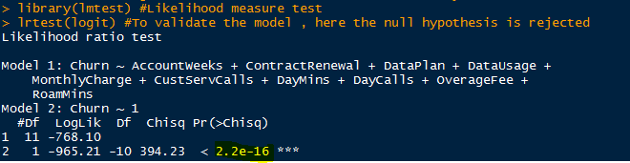
Likelihood measure test
The likelihood measure test was done to validate the entire model built using the glm function.
As the p value is significant , the null hypothesis is rejected that none of the predictor variables are having an impact on the dependent variable churn and it can be said that at least one of the predictor variables is having an impact on the dependent variable churn.

Slide 10
McFadden test
McFadden test was done to understand the % of uncertainty of the intercept model which has been explained by the full model.
The results od McFadden test says that if we take intercept model there is an 100% uncertainty but out of that now 20% has been explained by the full model. Hence 20% of the uncertainty of the intercept model has been explained by the full model.

Slide 11
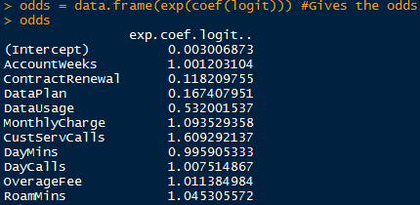
Odds Interpretation
The odds ratio suggests that customers can be retained if the monthly charges on the customers can be lowered down by decreasing the overcharge fees and improving the cust service calls so that customers get a prompt reply and solution to their issues when they call the customer service care.
Converting the odds to probability ,there is a 52% probability that the customer would be retained if the customer gets some discount or promotion in his monthly bill also there is a 62% probability that the customer would be retained if the customer gets a better service when the customer calls the service center , also automated systems can be developed to resolve customers issues so that the number of calls to service center would be decreased .

Slide 12


Model Validation
Model was validated using the 30% test model using various metrics like Confusion matrix and AUC curve.
Using the test model that was built on training dataset the classification error came out to be 14%
The AUC came out to be 58% which means randomly selected case from the group with the people who have churned has the score larger than that for a randomly chosen case from the group with the people who have not churned 58% of the time.

Slide 13
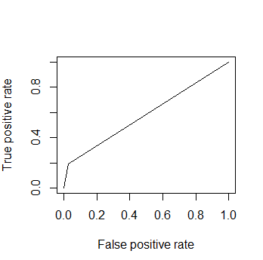
ROC Curves
It can be said from the ROC curve that the classifier does a good job in separating the classes also the AUC and the ROC curve for training and test model almost came out to be the same which suggests that the model is good enough to predict the propensity of the customers getting churned.

Slide 14
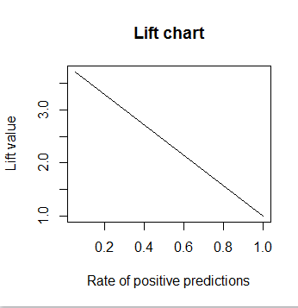
Lift Charts
The cumulative left chart suggest that by contacting 20% of the churned customers based on the predictive model we will be able to retain more than 3 times the customers who are churned.

Slide 15
Thank you

